Slide 1





TEAM <>
EV CHARGERS ACCESSIBILITY & AVAILABILITY
Alan
Christopher
Li
PSEG RUTGERS ANALYTICS BOOTCAMP PROGRAM
PROJECT 03
Bhagya
Bryan
14 APRIL 2024

Slide 2
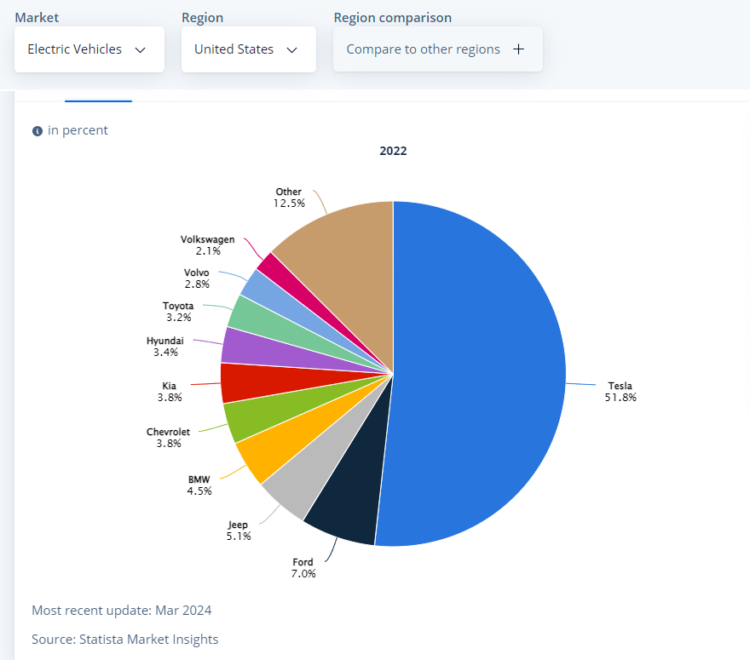
INTRODUCTION
IDEA & PURPOSE
Unit Sales expected to reach 2.46m vehicles in 2028
EV market projected to reach a revenue of US$82.8bn in 2024
EV demand driven by government incentives & increasing environmental consciousness among consumers.

Slide 3














DATA ANALYSIS DESIGN & TECHNOLOGY ARCHITECTURE
DEFINE
the Problem
GATHER
the Data
COMMUNICATE
Results
Finding operational EV Charging Stations within a driving range late, inclement weather
Identifying the data source & Collecting data
Access the results on a lightweight browser
Web server &
JSP Engine
Client JSP & Browser
Extract | Transform | Load
Database
CLEAN & PREPARE the Data
EXPLORE
the Data
BUILD
Object Models
Cleaning the data using Pandas Dataframe & SQL Preparing the data in AWS RDS PostgreSQL
Looking for patterns of EV chargers applying several filters & criteria
Fine tuning the size of the data
Build real time Object Models based on characteristics or criteria for client access

Slide 4

OBSTACLES | SOLUTIONS
CATEGORY | CHALLENGES | SOLUTION/WORKAROUND
API | Number of hits [more than 100 hits chargeable] | Limit the number of EV chargers and picked only for United States Monitored the number of hits per API Key
 | Difficulties to build relationships without robust documentation and data definitions | Resorted to pulled data by EV within a region or a lessened the radius of the co-ordinates
OBJECT MODEL | Integrating NodeJS using AWS Lambda within a limited time | Leveraged GitHub IO to expose data based on selection criteria
POSTGRESQL SECURITY | Establishing connectivity from Python to PostgreSQL hosted in AWS | Applied parameterized role to override the default role allowing connection into the database

Slide 5
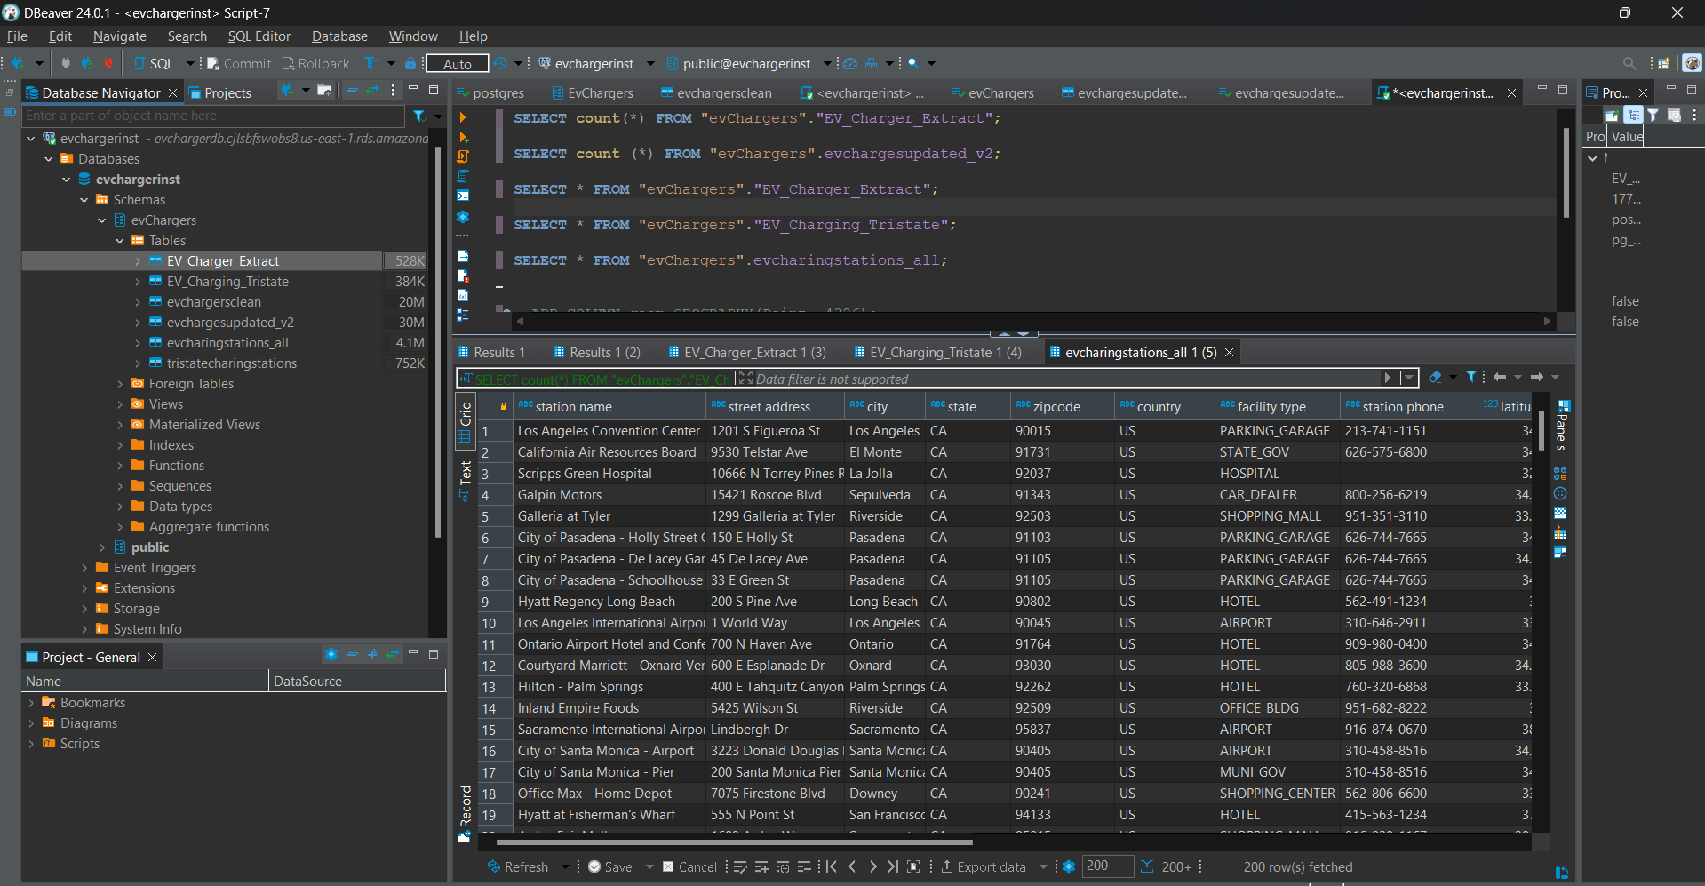
PostgreSQL AWS RDS – ETL Process
Data pulled from the API
Imported using Python script
Destination: AWS RDS PostgreSQL Database
Database Name: evchargerinst
Schema: evChargers
Table Name: EV_Charger_Extract
Initially extracted a larger dataset with over 80k records for all charging stations across the USA.
Limited to records from the tristate area due to API token restrictions.

Slide 6
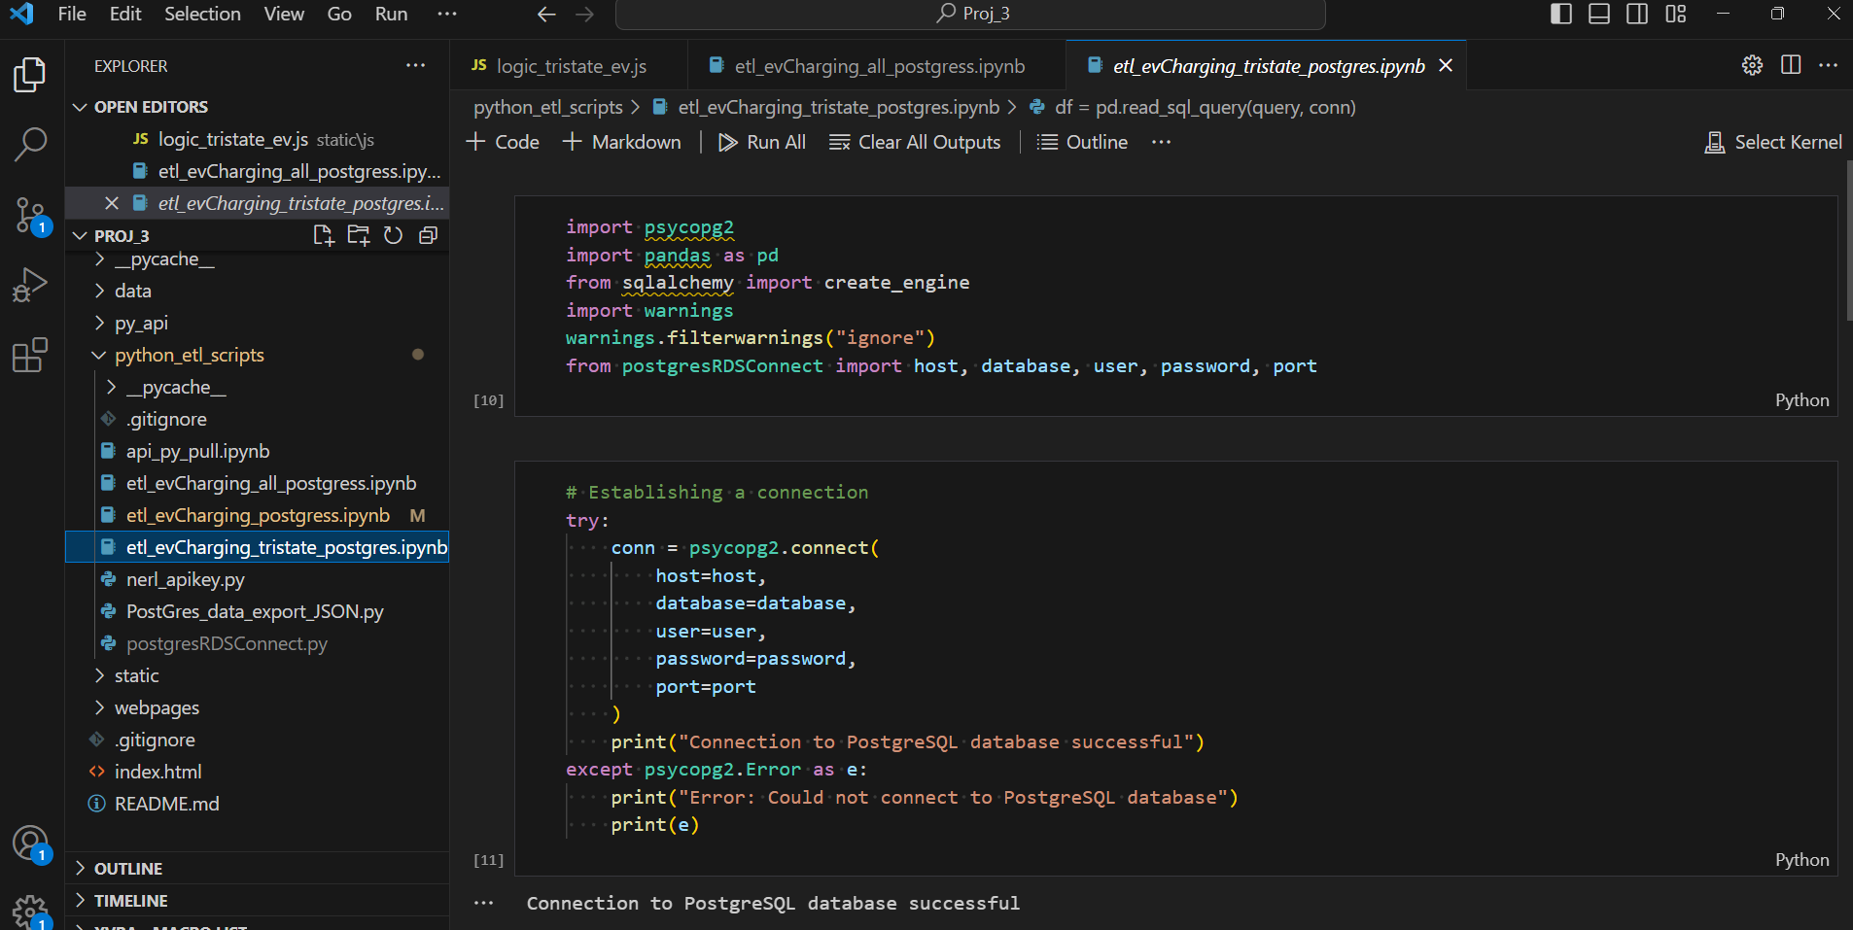
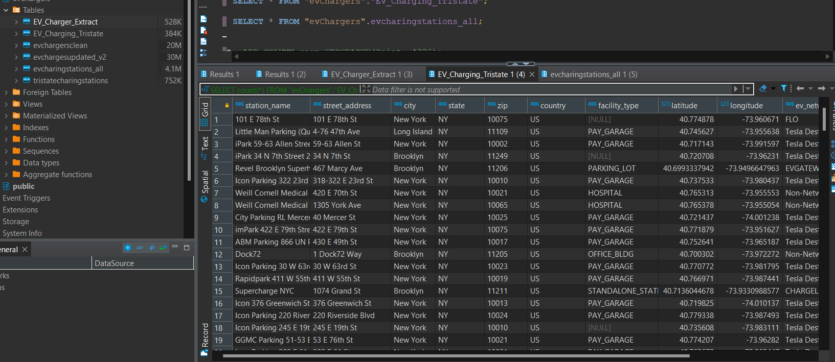
ETL Process - Continued
Utilized a Python Jupyter notebook for data cleaning
Used the "psycopg2" library to interact with the AWS RDS PostgreSQL Database
Cleaned the dataframe to generate a new dataset
Written the cleaned dataframe back to the database
Destination: AWS RDS PostgreSQL Database
Database Name: evchargerinst
Schema: evChargers
New Table Name: EV_Charging_Tristate

Slide 7
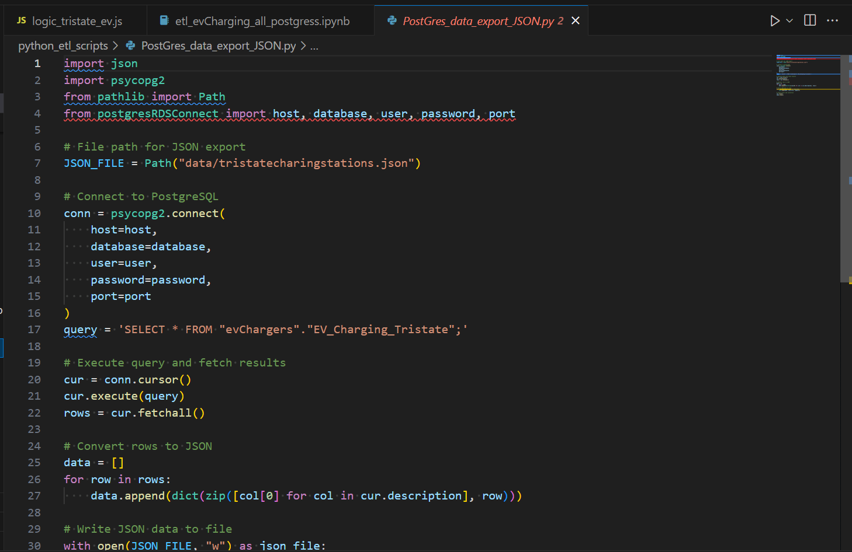
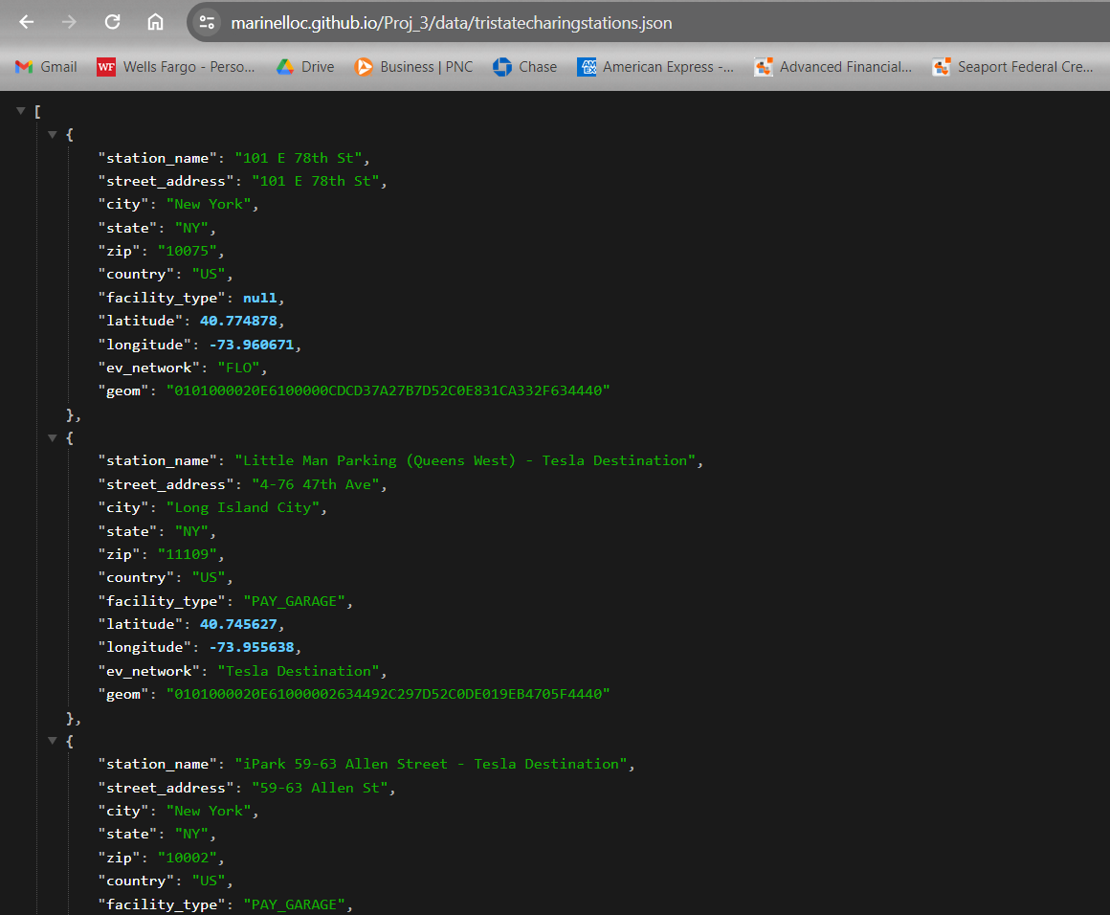
ETL – PostgreSQL -> JSON -> GitHub Static API
Developed a Python script within the pipeline to extract the clean dataset to a JSON file.
After extraction, added the data to GitHub to establish a static API webpage.
The static API webpage is accessible at the following URL: https://marinelloc.github.io/Proj_3/data/tristatecharingstations.json

Slide 8
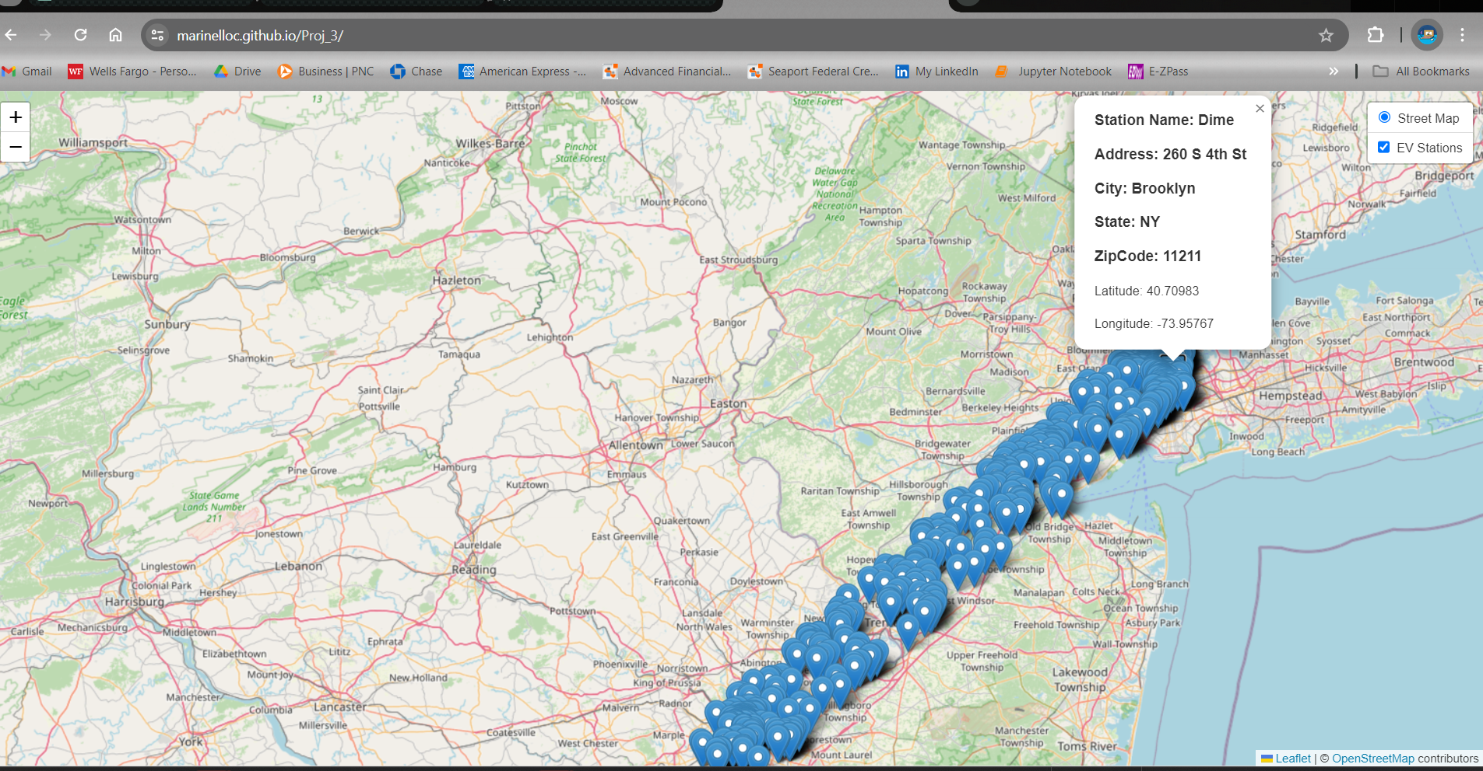
GitHub Static EvChargers JS-> index.html
Retrieved data from the API for integration into JavaScript logic.
Incorporated the data into the JavaScript code.
Integrated the JavaScript code into the index.html file.
Utilized Live Server to preview the data.
Deployed a static webpage on GitHub to make the data publicly accessible.
The static webpage can be viewed at: https://marinelloc.github.io/Proj_3/

Slide 9
Web App Design
1. index.html
Purpose:
Renders the main HTML structure.
Links necessary libraries and stylesheets.
Defines the layout of the web page.
2. style.css
Purpose:
Defines styles for HTML elements.
Customizes the appearance of the web page.
Ensures consistency in design and layout.
3. logic.js
Purpose:
Implements client-side JavaScript logic.
Initializes the Leaflet map and tile layers.
Fetches data from the server based on user interactions.
4. server.js
Purpose:
Sets up an Express server.
Handles requests to fetch data from a PostgreSQL database.
Manages CORS and database connections.

Slide 10





CONCLUSION | ACKNOWLEDGEMENTS
Raina Gustafson
Sheri Rosalia
Jeanette Luu
Enkhsanaa Sommers

Slide 11
REFERENCE
MARKET
Electrical Vehicle Growth – United States
DATA & API
NREL API – EV DATA
TECHNOLOGY
RDS PostgreSQL DB in AWS
RDS connection

